Slide 1
Knowbility – Equal Access to technology for people with disabilities
Is there a Business Case For Digital Accessibility?

Slide 2
Accessibility means
People with disabilities
…can acquire the same information
…perform the same functions
…be active producers of content
…have interactive online experiences
equivalent to any other user

Slide 3
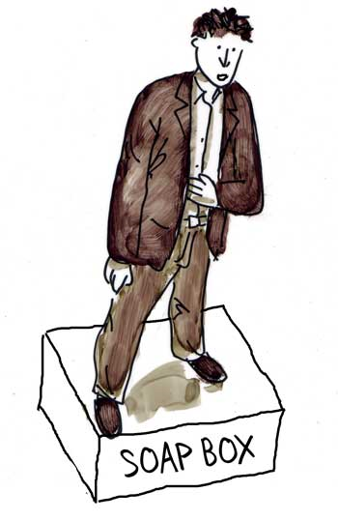
Many approaches to accessibility
Legal
Technical
Market
Humanitarian Innovation

Slide 4
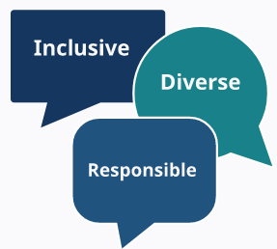
Studies show that digital accessibility….
Drives Innovation
Increases Market Share
Drives Innovation,
Increases Market Share
Enhances Brand Awareness
Reduces legal risk
Enhances brand
Reduces Legal Risk

Slide 5
Telephone
Email
Wheelchair ramps
Automatic doors
Speech to text
The accessibility problems of today are the mainstream breakthroughs of tomorrow.
~ Eve Andersson, Director, Accessibility Engineering, Google
Drive Innovation
Drives Innovation,
Increases Market Share

Slide 6
Enhance your brand
Closely aligned to diversity and inclusion initiatives
Employing people with disabilities requires accessible digital tools
Accessibility commitment demonstrates Corporate Social Responsibility
Accessibility is a core value at Apple and something we view as a basic human right.
~ Sarah Herrlinger, Director of Global Accessibility, Apple

Slide 7
1 billion potential customers (and their families!)
Loyal to accessible services
Results in more usable products
Designing inclusive software results in improved usability, customer satisfaction, and retention.
~ Microsoft’s app developer guide
Increase Market Share
Increases Market Share

Slide 8
UN Convention on Rights of PWD
European Union Directive
US Section 508
Courts increasingly citing ADA
Lawsuits increasing
Inclusive design is simply good design
Reduce Legal Risk
Drives Innovation,
Increases Market Share

Slide 9
Getting Started
Free resources from W3C (www.w3.org/wai) include:
Accessibility Principles
How people with disabilities use the web
Technical Tutorials
Accessibility statement generator
…much more
AccessU Digital Accessibility Training Conference May 13 and May 18-20
https://knowbility.org/programs/

Slide 10
Video Introduction to Accessbility from w3c
https://youtu.be/20SHvU2PKsM
The power of the Web is in its universality. Access by everyone regardless of disability is an essential aspect. ~ Tim Berners-Lee

Slide 11
Steps to accessibility
Recruit executive sponsor
Develop explicit policy
Set goals (listen to your stakeholders)
Access current status
Establish management structure
Assign responsibilities across roles
Provide training
Integrate support structures
Test, measure, report
Inclusive practice is sustained through iteration
Planning and Managing Guide at W3C/WAI
https://www.w3.org/WAI/planning-and-managing/

Slide 12
Thank you! @knowbility www.knowbility.org
Baked in accessibility is cheaper, faster, works better for ALL users.
Businesses make better products, services when they
design with that understanding

